Slide 1
Movie Recommendation
Strength in providing enhanced entertainment
Guruprasad N Bamane - PES1UG19CS174
S Usha Priya - PES1UG19CS407
Shamitha S - PES1UG19CS448

Slide 2
TOC
Problem Statement
Dataset
Importance of problem
Brief of the project
Initial insights
Implementation approach
Evaluation of algorithm
Inference from data or process
Conclusion
Contribution of each team member

Slide 3
Problem Statement
Ever in this busy world, amidst the work throttle, there has always been a need for the source of entertainment. Even though there are many existing forms of killing time, the one which definitely has its place is movies or films. It would rather be troublesome and time consuming to surf through people or sites to decide upon which show to spend on. One would obviously let someone or something to suggest movies or shows based on their interest.
This is where Movie Recommendation System takes its place !

Slide 4
Dataset
Two datasets tmdb and movies are considered with each
one having other 2 datasets. Tmdb has tmdb_5000_movies
and tmdb_5000_credits each having (4804,20) and (4814,4)
dimensions respectively.
Movie’s dataset has movies and ratings with (9743,3) and
(100827,4) rows and columns respectively.
Source:
https://www.kaggle.com/tmdb/tmdbmovie-metadata
https://drive.google.com/file/d/1WWQCl9w52M1sXNWd4JSKL7q-HHywk03p/view

Slide 5
Importance of problem
01
Recommender systems help to personalize a platform and help the user to find something they like.
02
A movie recommendation system is important in our social life due to its strength in providing constant entertainment. Such a system can suggest a set of movies to users based on their interest, or the popularities of the movies.
03
An automated recommender system reduces users’ effort and works in accordance with their willingness.

Slide 6
Brief of the project
Literature Review
EDA
Implementation (Model Building)
Content based filtering
Collaborative based filtering
Results

Slide 7
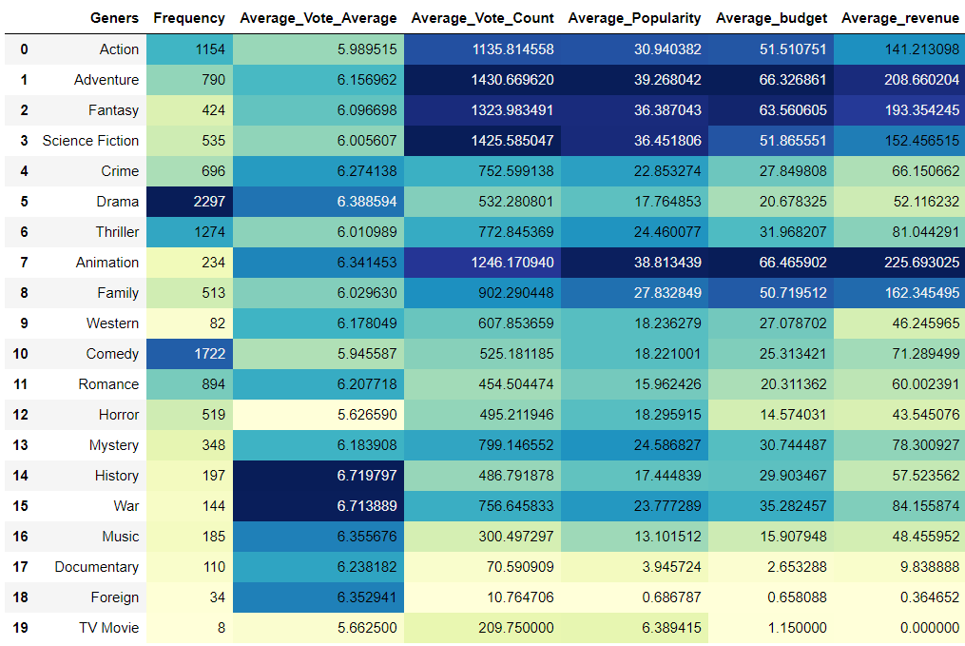
Initial Insights
Comparison of all genres with respect to the metrics like frequency, vote_average, vote_ count, average popularity, average_budget, average_revenue .
‘Adventure’ and ‘Animation’ genres dominate in vote_count, popularity, budget and revenue .
‘Drama’ and ‘Comedy’ counts for highest frequency.
‘History’ and ‘War’ top in vote_average.
‘TV Movie’ has lowest frequency.
‘Horror’ has least vote_average

Slide 8
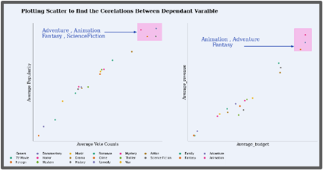
Initial Insights continued..
The scatter plots show that there is a
positive correlation between average_popularity and average_vote_counts
weak positive correlation between average_revenue and average_budget.

Slide 9
Implementation approach
Data Cleaning and Pre-processing:
Checking and handling of NULL values
Dealing with redundant data
Formatting Object(String) columns using split() and strip()
Merging data-frames
Normalization
Transformations
Building models and metrics
Content filtering - Weighted Average Scores
Content filtering based on user interest - Cosine Similarity
Content based filtering - Dot Product
Collaborative Filtering(User-user filtering) - KNN and Cosine Similarity
Collaborative Filtering - Pearson’s correlation coefficient
Drive link : https://drive.google.com/drive/folders/1rNJuS6qb1BuDKXDInno_u0m9adjL_YLe

Slide 10
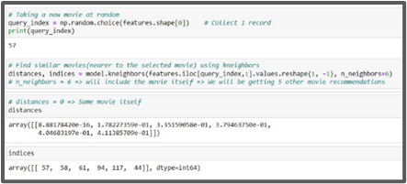
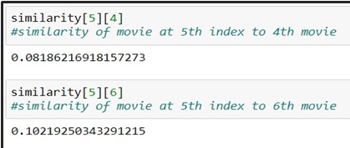
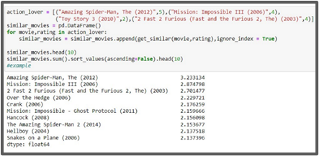
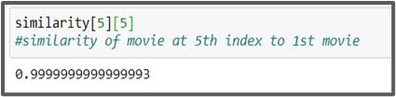
Evaluation of algorithm
CBF with KNN and Cosine Similarity
CBF based on user interest
CBF with Pearson Coefficient

Slide 11
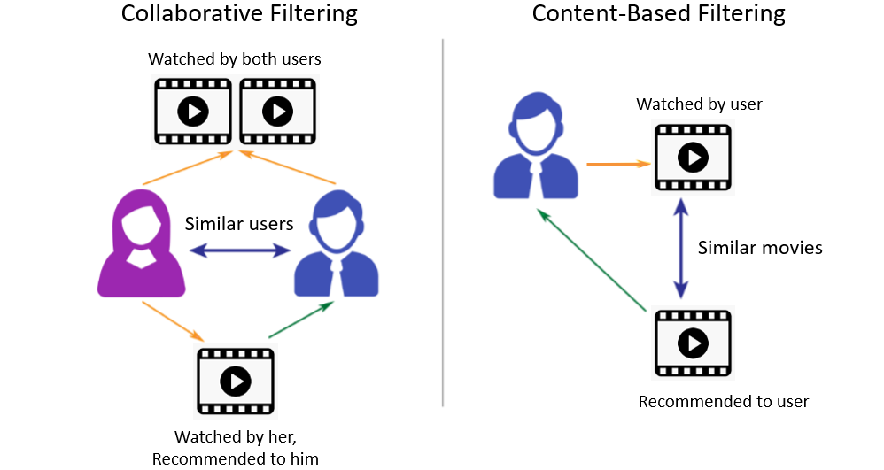
Inference of Data or Process
Content based or Collaborative Filtering both doesn’t give same recommendations as one deals solely on users’ interest whereas the other gets affected by similar users.
Recommendations might also differ based on the similarity metrics used.

Slide 12
Conclusion
In this project, we have proposed various solutions to the real time problem of movie recommendation. Our specified solution successfully makes appropriate recommendations given a movie based on different similarity metrics.
CBR models don't need any data about other users since the recommendations are specific to one user. This model can capture the specific interests of a user, and can even recommend nice movies that a very few users are interested in.
When it comes to CF, domain knowledge is not required because the embeddings are automatically learned. The model can help users discover new interests.

Slide 13
Contribution
Thank you!
Guruprasad N Bamane | PES1UG19CS174 | Building collaborative filtering models, Literature study, Final report
S Usha Priya | PES1UG19CS407 | Pre-processing, Visualizations, Literature study, Final report.
Shamitha S | PES1UG19CS448 | Building Content based filtering models, Visualizations, Literature study, Final report.

